Slide 1
Principles of Compiler Design
Chapter 1
Introduction

Slide 2
Preliminaries Required
Basic knowledge of Programming languages.
Basic knowledge of Automata and Context Free Grammar.
Textbook:
Alfred V. Aho, Ravi Sethi, and Jeffrey D. Ullman,
“Compilers: Principles, Techniques, and Tools”
Addison-Wesley, 2007.

Slide 3
Objectives
At the end of this session students will be able to:
Understand the basic concepts and principles of Compiler Design
Understand the term compiler, its functions and how it works.
Be familiar with the different classification of compilers.
Be familiar with cousins of compiler: Linkers, Loaders, Interpreters, Assemblers.
Understand the need of studying Compiler Design and Construction
Understand the Phases of Compilation and the steps of Compilation.

Slide 4
Compiler
A compiler is a program takes a program written in a source language and translates it into an equivalent program in a target language.
Source Program is normally a program written in a high-level language.
Target Program is normally the equivalent program in machine code (relocatable object file)
Compiler
Source Program
Target Program
Error message

Slide 5
Other Applications
In addition to the development of a compiler, the techniques used in compiler design can be applicable to many problems in computer science.
Techniques used in a lexical analyzer can be used in text editors, information retrieval system, and pattern recognition programs.
Techniques used in a parser can be used in a query processing system such as SQL.
Many softwares having a complex front-end may need techniques used in compiler design.
A symbolic equation solver which takes an equation as input. That program should parse the given input equation.
Most of the techniques used in compiler design can be used in Natural Language Processing (NLP) systems.

Slide 6
Why should we study Compilers
So why study compilers? Haven't all the compilers been written? There are several reasons for studying compilers.
Compilers are larger programs than the ones you have written in your programming courses. It is good to work with a program that is like the size of the programs you will be working on when you graduate.
Compilers make use of all those things you have learned about earlier: arrays, lists, queues, stacks, trees, graphs, maps, regular expressions and finite state automata, context-free grammars and parsers, recursion, and patterns. It is fun to use all of these in a real program.
You learn about the language you are compiling (in our case, Java).
You learn a lot about the target machine (in our case, the Java Virtual Machine).

Slide 7
Contd…
Compilers are still being written for new languages and targeted to new computer architectures. Yes, there are still compiler-writing jobs out there.
Compilers are finding their way into all sorts of applications, including games, phones, and entertainment devices.
XML Programs that process XML use compiler technology.
There is a mix of theory and practice, and each is relevant to the other.
The organization of a compiler is such that it can be written in stages, and each stage makes use of earlier stages. So, compiler writing is a case study in software engineering.
Compilers are programs. And writing programs is fun.

Slide 8
Classification of Compilers
Compilers viewed from many perspectives
Single Pass
Multiple Pass
Load & Go
Debugging
Optimizing
However, all utilize same basic tasks to accomplish their actions
Classifying compilers by number of passes has its background in the hardware resource limitations of computers.
Compiling involves performing lots of work and early computers did not have enough memory to contain one program that did all of this work.
So compilers were split up into smaller programs which each made a pass over the source (or some representation of it) performing some of the required analysis and translations.
Construction
Functional

Slide 9
Contd…
Single(One) Pass Compilers:- is a compiler that passes through the source code of each compilation unit only once
Also called narrow compilers.
The ability to compile in a single pass has classically been seen as a benefit because it simplifies the job of writing a compiler.
Single-pass compilers generally perform compilations faster than multi-pass compilers.
Due to the resource limitations of early systems, many early languages were specifically designed so that they could be compiled in a single pass (e.g., Pascal).
Disadvantage of single pass Compilers:
It is not possible to perform many of the sophisticated optimizations needed to generate high quality code.
It can be difficult to count exactly how many passes an optimizing compiler makes.
For instance, different phases of optimization may analyze one expression many times but only analyze another expression once.

Slide 10
Contd…
Multi-Pass Compilers:- is a type of compiler that processes the source code or abstract syntax tree of a program several times.
Also called wide compilers.
Phases are separate "Programs", which run sequentially
Here, by splitting the compiler up into small programs, correct programs will be produced.
Proving the correctness of a set of small programs often requires less effort than proving the correctness of a larger, single, equivalent program.
Many programming languages cannot be represented with a single pass compilers, for example most latest languages like Java require a multi-pass compiler.

Slide 11
Contd…
Load and Go Compilers:- generates machine code & then immediately executes it.
Compilers usually produce either absolute code that is executed immediately upon conclusion of the compilation or object code that is transformed by a linking loader into absolute code.
These compiler organizations will be called Load & Go and Link/Load.
Both Load & Go and Link/Load compilers use a number of passes to translate the source program into absolute code.
A pass reads some form of the source program, transforms it into an another form, and normally outputs this form to an intermediate file which may be the input of a later pass.

Slide 12
Contd…
Optimizing Compilers:- is a compiler that tries to minimize or maximize some attributes of an executable computer program.
The most common requirement is to minimize the time taken to execute a program; a less common one is to minimize the amount of memory occupied.
The growth of portable computers has created a market for minimizing the power consumed by a program.
Compiler optimization is generally implemented using a sequence of optimizing transformations, algorithms which take a program and transform it to produce a semantically equivalent output program that uses fewer resources.
Types of Optimization includes Peephole optimizations, local optimization, global optimization, loop optimization, machine-code optimization, etc.

Slide 13
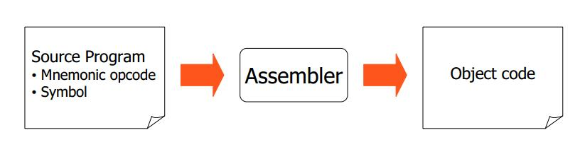
Cousins of Compiler
Assembler:- is a translator that converts programs written in assembly language into machine code.
Translate mnemonic operation codes to their machine language equivalents.
Assigning machine addresses to symbolic labels.

Slide 14
Contd…
Interpreter:- is a computer program that translates high level instructions/programs into machine code as they are encountered.
It produces output of statement as they are interpreted
It generally uses one of the following strategies for program execution:
execute the source code directly
translate source code into some efficient intermediate representation and immediately execute this
explicitly execute stored precompiled code made by a compiler which is part of the interpreter system

Slide 15
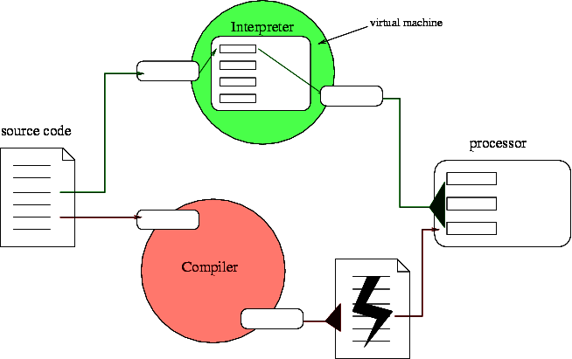
Contd…
source program
preprocessor
modified source program
compiler
target assembly program
assembler
Relocatable machine code
linker/loader
Library
files
target machine code
Linker:- is a program that takes one or more objects generated by a compiler and combines them into a single executable program.
Loader:- is the part of an operating system that is responsible for loading programs from executables (i.e., executable files) into memory, preparing them for execution and then executing them.

Slide 16
Compiler Vs Interpreter
Ideal concept:
Source code
Compiler
Executable
Input data
Output data
Executable
Source code
Output data
Input data
Interpreter
Most languages are usually thought of as using either one or the other:
Compilers: FORTRAN, COBOL, C, C++, Pascal, PL/1
Interpreters: Lisp, scheme, BASIC, APL, Perl, Python, Smalltalk
BUT: not always implemented this way

Slide 17

Basic Compiler Design
Write a huge program that takes as input another program in the source language for the compiler, and gives as output an executable that we can run.
For modifying code easily, usually, we use modular design (decomposition) methodology to design a compiler.
Two design strategies:
Write a “front end” of the compiler (i.e. the lexer, parser, semantic analyzer, and assembly tree generator), and write a separate back end for each platform that you want to support
Write an efficient highly optimized back end, and write a different front end for several languages, such as Fortran, C, C++, and Java.
Source
code
Front End
Intermediate
code
Back End
Target
code

Slide 18
The Major Parts of Compilers
There are two parts to compilation: Analysis & Synthesis.
During analysis, the operations implied by the source program are determined and recorded in a hierarchical structure called a tree.
During synthesis, the operations involved in producing translated code.
Analysis
Front
End
1. Lexical Analysis
2. Syntax Analysis
3. Semantic Analysis
Breaks up source program into constituent pieces
Creates intermediate representation of source program
Synthesis
Construct target program from intermediate representation
Takes the tree structure and translates the operations into the target program
Back
End
4. Code Generation
5. Optimization

Slide 19
Phases of Compiler
Source Program
Lexical Analyzer
Syntax Analyzer
Semantic Analyzer
Symbol Table
Manager
Error
Handler
Intermediate Code Generator
Code Optimizer
Code Optimizer
Target Program
Each phase transforms the source program from one representation into another representation.
They communicate with error handlers.
They communicate with the symbol table.

Slide 20
Phase I: Lexical Analyzer (Scanner)
Lexical Analyzer reads the source program character by character and returns the tokens of the source program.
A token describes a pattern of characters having same meaning in the source program. (such as identifiers, operators, keywords, numbers, delimiters and so on)
Ex: newval := oldval + 12 => tokens: newval identifier
:= assignment operator
oldval identifier
+ add operator
12 a number
Puts information about identifiers into the symbol table.
Regular expressions are used to describe tokens (lexical constructs).
A (Deterministic) Finite State Automaton can be used in the implementation of a lexical analyzer.

Slide 21
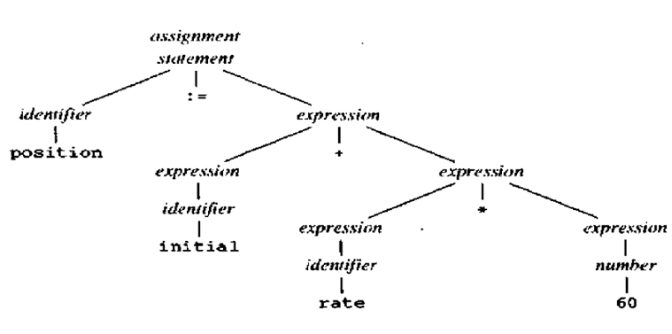
Phase II: Syntax Analyzer
A Syntax Analyzer creates the syntactic structure (generally a parse tree) of the given program.
A syntax analyzer is also called as a Parser.
A Parse tree describes a syntactic structure.
Constructed by repeated application of rules in Context Free Grammar (CFG)
Example: parse tree for position:=initial + rate*60
In a parse tree, all terminals are at leaves.
All inner nodes are non-terminals in a context free grammar.

Slide 22
Syntax Analyzer (CFG)
The syntax of a language is specified by a context free grammar (CFG).
The rules in a CFG are mostly recursive.
A syntax analyzer checks whether a given program satisfies the rules implied by a CFG or not.
If it satisfies, the syntax analyzer creates a parse tree for the given program.
Ex: We use BNF (Backus Naur Form) to specify a CFG
assgntmt -> identifier := expression
expression -> identifier
expression -> number
expression -> expression + expression

Slide 23
Parsing Techniques
Depending on how the parse tree is created, there are different parsing techniques.
These parsing techniques are categorized into two groups:
Top-Down Parsing,
Bottom-Up Parsing
Top-Down Parsing:
Construction of the parse tree starts at the root, and proceeds towards the leaves.
Efficient top-down parsers can be easily constructed by hand.
Recursive Predictive Parsing, Non-Recursive Predictive Parsing (LL Parsing).
Bottom-Up Parsing:
Construction of the parse tree starts at the leaves, and proceeds towards the root.
Normally efficient bottom-up parsers are created with the help of some software tools.
Bottom-up parsing is also known as shift-reduce parsing.
Operator-Precedence Parsing – simple, restrictive, easy to implement
LR Parsing – much general form of shift-reduce parsing, LR, SLR, LALR

Slide 24
Phase III: Semantic Analyzer
A Semantic Analyzer checks the source program for semantic errors and collects the type information for the code generation.
Type-checking is an important part of semantic analyzer.
Normally semantic information cannot be represented by a context-free language used in syntax analyzers.
Context-free grammars used in the syntax analysis are integrated with attributes (semantic rules)
the result is a syntax-directed translation,
Attribute grammars
Ex: newval := oldval + 12
The type of the identifier newval must match with type of the expression (oldval+12)

Slide 25
Phase IV: Intermediate Code Generation
A compiler may produce an explicit intermediate codes representing the source program.
These intermediate codes are generally machine codes(architecture independent).
Ex:
newval := oldval * fact + 1
id1 := id2 * id3 + 1
MULT id2,id3,temp1 Intermediates Codes (Quadruples)
ADD temp1,#1,temp2
MOV temp2,,id1

Slide 26
Phase V: Code Optimizer
The code optimizer optimizes the code produced by the intermediate code generator in the terms of time and space.
Ex: MULT id2,id3,temp1
ADD temp1,#1,id1
Phase VI: Code Generator
Produces the target language in a specific architecture.
The target program is normally is a relocatable object file containing the machine codes.
Ex: ( assume that we have an architecture with instructions whose at least one of its operands is
a machine register)
MOVE id2,R1
MULT id3,R1
ADD #1,R1
MOVE R1,id1

Slide 27
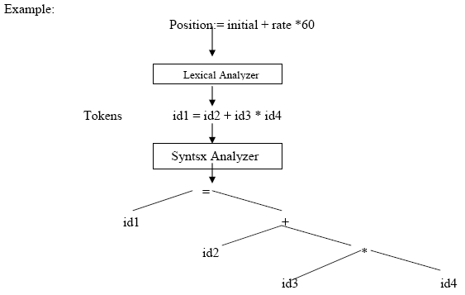
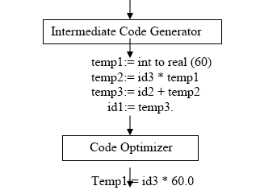
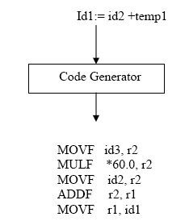
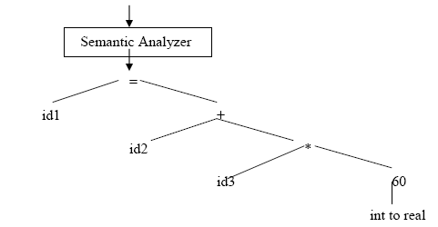
Summary of Phases of Compiler

Slide 28
Compiler-Construction Tools
Software development tools are available to implement one or more compiler phases
Scanner generators
Parser generators.
Syntax-directed translation engines
Automatic code generators
Data Flow Engines
Other compiler tools:
JavaCC, a parser generator for Java, including scanner generator and parser generator. Input specifications are different than those suitable for Lex/YACC. Also, unlike YACC, JavaCC generates a top-down parser.
ANTLR, a set of language translation tools (formerly PCCTS). Includes scanner/parser generators for C, C++, and Java.
Scanner generators for C/C++: Flex, Lex.
Parser generators for C/C++: Bison, YACC.
Available scanner generators for Java:
JLex, a scanner generator for Java, very similar to Lex.
JFlex, flex for Java.
Available parser generators for Java:
CUP, a parser generator for Java, very similar to YACC.
BYACC/J, a different version of Berkeley YACC for Java. It is an extension of the standard YACC (a -j flag has been added to generate Java code).

Slide 29
The Grouping of Phases
Compiler front and back ends:
Front end: analysis (machine independent)
Back end: synthesis (machine dependent)
Compiler passes:
A collection of phases is done only once (single pass) or multiple times (multi pass)
Single pass: usually requires everything to be defined before being used in source program
Multi pass: compiler may have to keep entire program representation in memory

Slide 30
Assignment I
Compiler Design Tools
?
Thank You ...

